Slide 1
Algorithm Input/Output
Input
Topology: a graph of switches and links
Lossless routes: the set of all routing paths that must be lossless
Output
The Tag-based ACL rules and buffer configuration, s.t.,
There is never cyclic buffer dependency (deadlock free)
Never drop packets that follow lossless routes
Assumption
There is a tagging system that tags the packet along the path.
Our design goal: minimize the # of lossless priorities and # of ACL rules

Slide 2
Tagging System
Requirements
Tags are changed monotonically along any packet’s path
On each switch, packets are classified into different priority classes purely based on the tags
We have good heuristics for Clos and BCube
For general graphs, TTL is always a feasible solution
However, it may not be optimal in terms of # of tags used – affecting the # of ACL rules

Slide 3
Notations
Input
Topology
Lossless routes
A_{i} represents a unique ingress port: switch A’s i^{th} ingress port
(A_{i}, x) is a port-tag pair: the case where A_{i} gets a packet with tag=x
V is the set of all port-tag pairs that appear in input lossless routes
(A_{i}, x) → (B_{j}, y) is a hop. It is essentially a buffer dependency.
There exists a hop iff switch A and B are connected, AND switch A may change the tag from x to y before sending to B
E is the set of all hops whose two ends are both in V
G=(V, E) is the lossless graph.

Slide 4
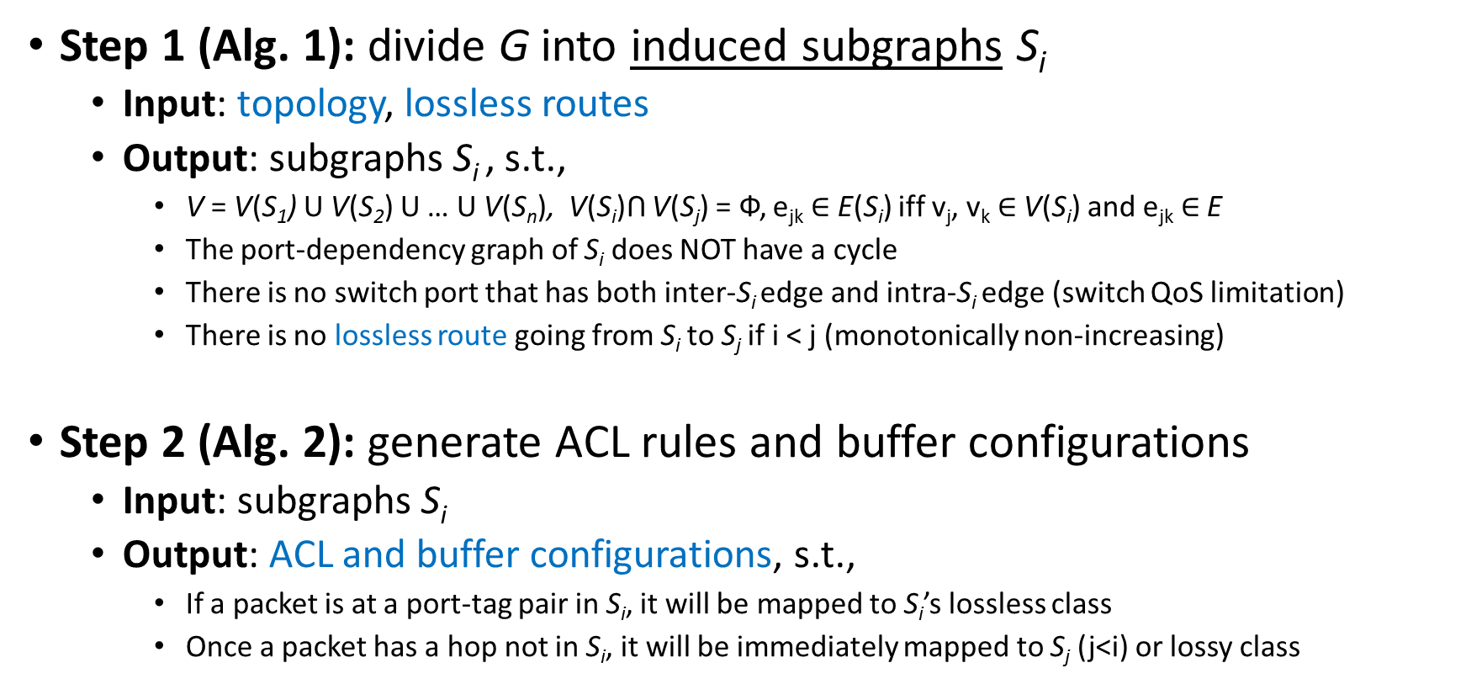
Algorithm Sketch
A_{i} | Switch A’s i^{th} ingress port
(A_{i}, x) | Port-tag pair
(,)->(,) | A hop
V | All port-tag pairs in lossless routes
E | All lossless hops
G | G(V, E) Lossless graph
Input
Topology
Lossless routes
Step 1 (Alg. 1): divide G into induced subgraphs S_{i}
Input: topology, lossless routes
Output: subgraphs S_{i} , s.t.,
V = V(S₁) U V(S₂) U … U V(S_{n}), V(S_{i})ꓵ V(S_{j}) = Ф, e_{jk} $∈$ E(S_{i}) iff v_{j}, v_{k} $∈$ V(S_{i}) and e_{jk} $∈$ E
The port-dependency graph of S_{i} does NOT have a cycle
There is no switch port that has both inter-S_{i} edge and intra-S_{i} edge (switch QoS limitation)
There is no lossless route going from S_{i} to S_{j} if i < j (monotonically non-increasing)
Step 2 (Alg. 2): generate ACL rules and buffer configurations
Input: subgraphs S_{i}
Output: ACL and buffer configurations, s.t.,
If a packet is at a port-tag pair in S_{i}, it will be mapped to S_{i}’s lossless class
Once a packet has a hop not in S_{i}, it will be immediately mapped to S_{j} (j<i) or lossy class
Subgraphs whose vertexes are a subset of V, edges exist iff they are present in E

Slide 5
Alg. 1
A_{i} | Switch A’s i^{th} ingress port
(A_{i}, x) | Port-tag pair
(,)->(,) | A hop
V | All port-tag pairs in lossless routes
E | All lossless hops
G | G(V, E) Lossless graph
Input
Topology
Lossless routes
For general graph, at least we have a greedy algorithm
var output=Set(); var S=Set(); output.add(S);
for (t=initial_tag; t>=0;)
var left_over = False;
4. for each port-tag pair v in the form of (A_{i}, t) in V
5. S’ ← S U {v}
6. if PDG(S’) is acyclic and does not have an edge same as inter-S, S ←S’, V ← V \ {v};
7. otherwise, left_over = True;
8. if left_over, S=Set(), output.add(S);
9. otherwise, t--;
The Set output is how we divide G.
This may not be optimal. Worst case: |output| = the diameter of G
PDG(): port dependency graph

Slide 6
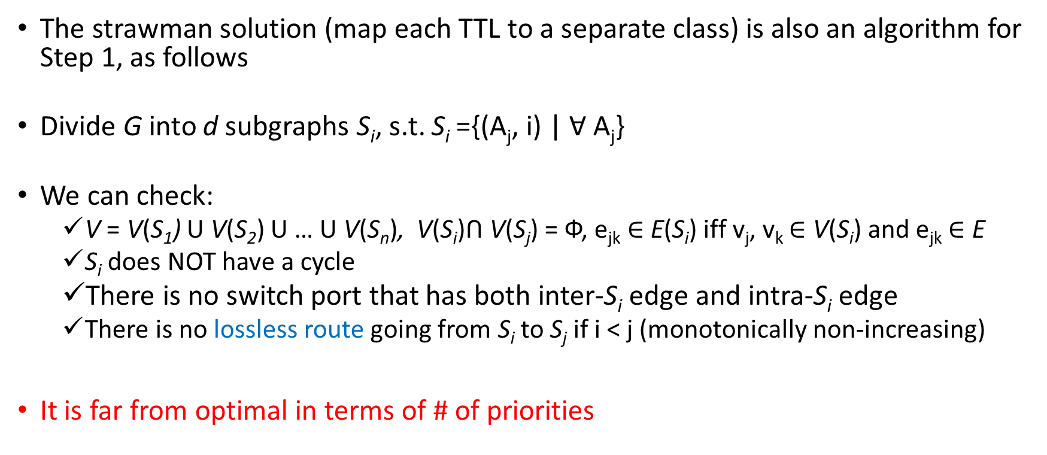
Side Note: Strawman
Input
Topology
Lossless routes
A_{i} | Switch A’s i^{th} ingress port
(A_{i}, x) | Port-tag pair
(,)->(,) | A hop
V | All port-tag pairs in lossless routes
E | All lossless hops
G | G(V, E) Lossless graph
The strawman solution (map each TTL to a separate class) is also an algorithm for Step 1, as follows
Divide G into d subgraphs S_{i}, s.t. S_{i} ={(A_{j}, i) | Ɐ A_{j}}
We can check:
V = V(S₁) U V(S₂) U … U V(S_{n}), V(S_{i})ꓵ V(S_{j}) = Ф, e_{jk} $∈$ E(S_{i}) iff v_{j}, v_{k} $∈$ V(S_{i}) and e_{jk} $∈$ E
S_{i} does NOT have a cycle
There is no switch port that has both inter-S_{i} edge and intra-S_{i} edge
There is no lossless route going from S_{i} to S_{j} if i < j (monotonically non-increasing)
It is far from optimal in terms of # of priorities

Slide 7
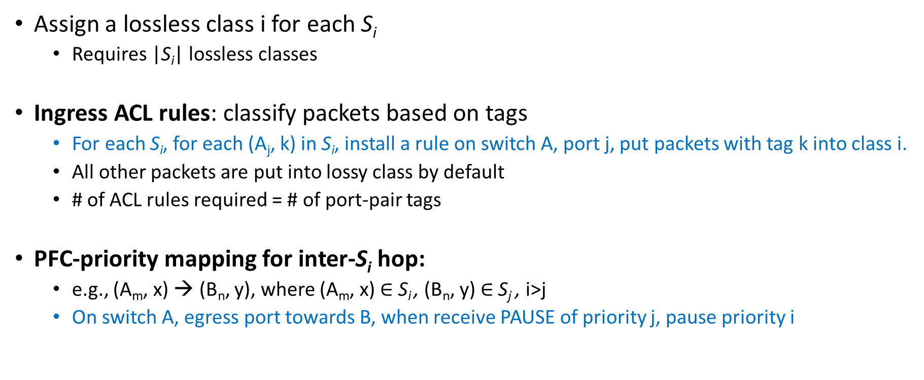
Alg. 2 (Generate Switch Configs)
A_{i} | Switch A’s i^{th} ingress port
(A_{i}, x) | Port-tag pair
(,)->(,) | A hop
V | All port-tag pairs in lossless routes
E | All lossless hops
G | G(V, E) Lossless graph
Assign a lossless class i for each S_{i}
Requires |S_{i}| lossless classes
Ingress ACL rules: classify packets based on tags
For each S_{i}, for each (A_{j}, k) in S_{i}, install a rule on switch A, port j, put packets with tag k into class i.
All other packets are put into lossy class by default
# of ACL rules required = # of port-pair tags
PFC-priority mapping for inter-S_{i} hop:
e.g., (A_{m}, x) → (B_{n}, y), where (A_{m}, x) $∈$ S_{i} , (B_{n}, y) $∈$S_{j} , i>j
On switch A, egress port towards B, when receive PAUSE of priority j, pause priority i

Slide 8
Example
A 3-node topology with TTL as the tagging system

Slide 9
Assume we send packets with initial TTL=8
N = {
(D, 8), (A₁, 7), (B₁, 6), (E₁, 5),
(D, 8), (A₁, 7), (C₁, 6), (B₄, 5), (E₁, 4),
(E, 8), (B₂, 7), (A₃, 6), (D₁, 5),
(E, 8), (B₂, 7), (C₃, 6), (A₄, 5), (D₁, 4),
(D, 8), (A₁, 7), (C₁, 6), (F₁, 5),
(D, 8), (A₁, 7), (B₁, 6), (C₃, 5), (F₁, 4),
(F, 8), (C₄, 7), (A₄, 6), (D₁, 5),
(F, 8), (C₄, 7), (B₄, 6), (A₃, 5), (D₁, 4),
(E, 8), (B₂, 7), (C₃, 6), (F₁, 5),
(F, 8), (C₄, 7), (B₄, 6), (E₁, 5),
(E, 8), (B₂, 7), (A₃, 6), (C₁, 5), (F₁, 4),
(F, 8), (C₄, 7), (A₄, 6), (B₁, 5), (E₁, 4)
}
The grey ones are duplicated. We sort N by TTL:
N={
(D, 8), (E, 8), (F, 8), (A₁, 7), (B₂, 7), (C₄, 7), (B₁, 6), (C₁, 6),
(A₃, 6), (C₃, 6), (A₄, 6), (B₄, 6), (E₁, 5), (B₄, 5), (D₁, 5), (A₄, 5),
(F₁, 5), (C₃, 5), (A₃, 5), (C₁, 5), (B₁, 5), (E₁, 4), (D₁, 4), (F₁, 4)
}
F
1
Routing:
D->A->B->E
D->A->C->B-E
E->B->A->D
E->B->C->A->D
D->A->C->F
D->A->B->C->F
F->C->A->D
F->C->B->A->D
E->B->C->F
F->C->B->E
E->B->A->C->F
F->C->A->B->E
4
C
1
3
2
D
4
4
A
B
1
1
3
1
3
2
2
1
E

Slide 10
N={
(D, 8), (E, 8), (F, 8), (A₁, 7), (B₂, 7), (C₄, 7), (B₁, 6), (C₁, 6),
(A₃, 6), (C₃, 6), (A₄, 6), (B₄, 6), (E₁, 5), (B₄, 5), (D₁, 5), (A₄, 5),
(F₁, 5), (C₃, 5), (A₃, 5), (C₁, 5), (B₁, 5), (E₁, 4), (D₁, 4), (F₁, 4)
}
A₃,5
A₄,5
A₃,6
D,8
A₁,7
D₁,5
D₁,4
A₄,6
B₁,5
B₁,6
E,8
B₂,7
B₄,5
E₁,4
B₄,6
E₁,5
C₁,6
F,8
C₄,7
C₁,5
F₁,4
C₃,6
C₃,5
F₁,5
Lossless Graph G

Slide 11
Alg. 1
A₃
D
A₁
D₁
A₄
S₂={
(D, 8), (E, 8), (F, 8), (A₁, 7), (B₂, 7), (C₄, 7), (B₁, 6), (C₁, 6),
(A₃, 6), (C₃, 6), (A₄, 6), (B₄, 6), (B₄, 5), (A₄, 5), (B₁, 5),
(D₁, 5), (E₁, 5), (F₁, 5),
}
S₁={
(C₃, 5), (A₃, 5), (C₁, 5), (E₁, 4), (D₁, 4), (F₁, 4)
}
Inter-S_{i} edges:
(B₁, 6)→(C₃, 5), (B₄, 6)→(C₃, 5),
(B₁, 6)→ (A₃, 5), (B₄, 6)→ (A₃, 5),
(A₃, 6)→(C₁, 5), (A₄, 6)→(C₁, 5),
(A₄, 5)→(D₁, 4), (B₁, 5)→(E₁, 4), (B₄, 5)→(E₁, 4),
B₁
E₁
E
B₂
B₄
F
C₄
C₁
F₁
C₃
A₃
A₃
D₁
A₄
C₁
E₁
B₁
B₄
C₃
F₁

Slide 12
Alg. 2
Two lossless classes (class 2 and class 1), one lossy class (class 0)
24 ACL rules
18 for class 2, 6 for class 1
PFC-priority map config on 4 ports (for inter-S_{i} edges)

